Slide 1
Basics of market-basket model

Slide 2
Overview of this video
Here, we start on the main way we are going to do data-mining, namely using the market-basket model

Slide 3
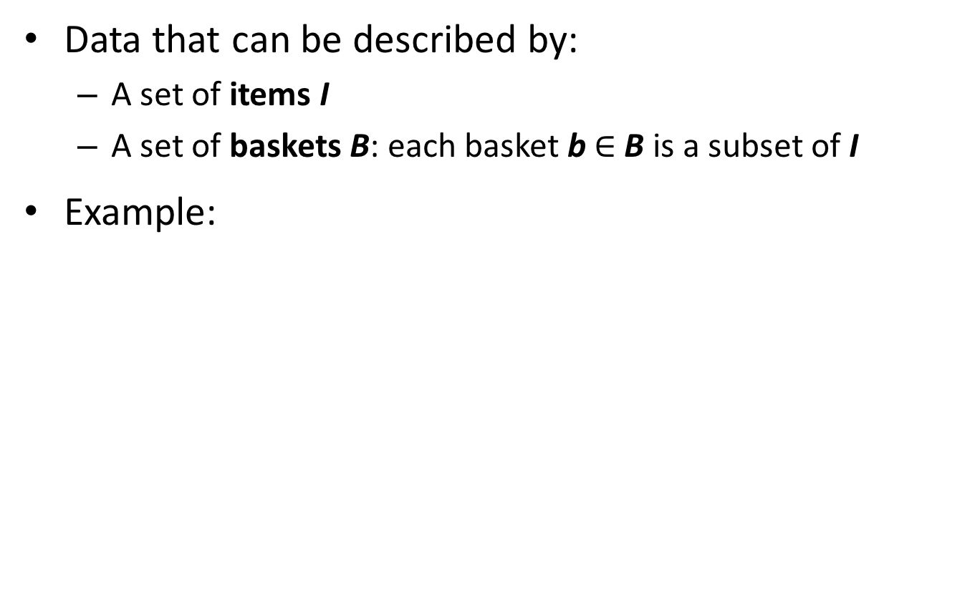
Market-Basket Data
Data that can be described by:
A set of items I
A set of baskets B: each basket b $∈$ B is a subset of I
Example:
Purchase ID | Items bought
101 | milk, bread, cookies, juice
792 | milk, juice
1130 | milk, bread, eggs
1735 | bread, cookies, coffee
b₁ = {milk, bread, cookies, juice}
b₂ = {milk, juice}
b₃ = {milk, bread, eggs}
b₄ = {bread, cookies, coffee}
I = {bread, coffee, cookies, eggs, juice, milk}
B = {b₁, b₂, b₃, b₄}

Slide 4
Another Example
Films | Liked by…
Bourne Identity | Anna, Chloe, Dave, Emma, Fred, Henry
Bourne Supremacy | Anna, Dave, Emma, Gwen, Henry
Bourne Ultimatum | Anna, Emma, Fred
Harry Potter 1 | Ben, Chloe, Dave, Emma, Gwen, Henry
Harry Potter 2 | Ben, Dave, Gwen, Henry
Harry Potter 3 | Ben, Henry
I = {Anna, Ben, Chloe, Dave, Emma, Fred, Gwen, Henry}
B = {b₁, b₂, b₃, b₄, b₅, b₆}
b₁ = {Anna, Chloe, Dave, Emma, Fred, Henry}
b₂ = {Anna, Dave, Emma, Gwen, Henry}
…

Slide 5
Frequent-Itemset Mining
Given:
Set of items I
Set of baskets B
Basic problem:
How frequent is “frequently”?
Purchase ID | Items bought
101 | milk, bread, cookies, juice
792 | milk, juice
1130 | milk, bread, eggs
1735 | bread, cookies, coffee
Which items occur frequently together in a basket?
“Diapers and beer are frequently bought together.”
“Harry Potter 1 and Game of Thrones are frequently liked by the same viewers.”

Slide 6
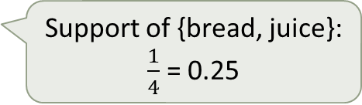
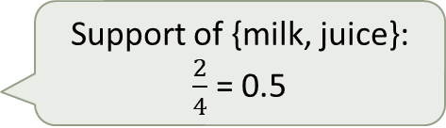
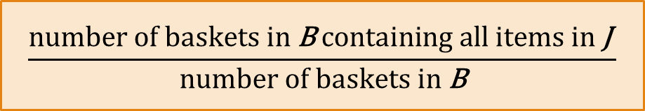
Support of an Itemset
Given: set of items I and set of baskets B
Support of a subset J of I = frequency with which the items in J occur together in a basket in B
Support of {milk, juice}: $\frac{2}{4}$ = 0.5
Purchase ID | Items bought
101 | milk, bread, cookies, juice
792 | milk, juice
1130 | milk, bread, eggs
1735 | bread, cookies, coffee
Support of {bread, juice}: $\frac{1}{4}$ = 0.25
$$\frac{\text{number} \text{of} \text{baskets} \text{in} \text{B} \text{containing} \text{all} \text{items} \text{in} \text{J} }{\text{number} \text{of} \text{baskets} \text{in} \text{B}}$$

Slide 7
Frequent Itemsets
Given: set of items I and set of baskets B
A subset J of I is frequent if its support is at least s.
s: support threshold (specified by user)
Example (s = 0.5)
{milk, juice} is frequent
{bread, juice} is not frequent
Support of {milk, juice}: $\frac{2}{4}$ = 0.5
Purchase ID | Items bought
101 | milk, bread, cookies, juice
792 | milk, juice
1130 | milk, bread, eggs
1735 | bread, cookies, coffee
Support of {bread, juice}: $\frac{1}{4}$ = 0.25

Slide 8
Example
Viewer | Liked videos
Anna | BI, BS, BU
Ben | HP1, HP2, HP3
Chloe | BI, HP1
Dave | BI, BS, HP1, HP2
Emma | BI, BS, BU, HP1
Fred | BI, BU
Gwen | BS, HP1, HP2
Henry | BI, BS, HP1, HP2, HP3
What is the support of {BI, BS}?
Is it frequent if the support threshold is s = 1/2?
Which sets consisting of two items are frequent (with s = 1/2)?
1/2
Yes

Slide 9
Frequent pairs
Viewer | Liked videos
Anna | BI, BS, BU
Ben | HP1, HP2, HP3
Chloe | BI, HP1
Dave | BI, BS, HP1, HP2
Emma | BI, BS, BU, HP1
Fred | BI, BU
Gwen | BS, HP1, HP2
Henry | BI, BS, HP1, HP2, HP3
All frequent pairs of two items with support threshold s = 1/2: {BI, BS}, {BI, HP1}, {BS, HP1}, {HP1, HP2}

Slide 10
Summary
Here we saw the basics of the market-basket model

